Slide 1


Slide 2
Database Systems
History & Context

Slide 3
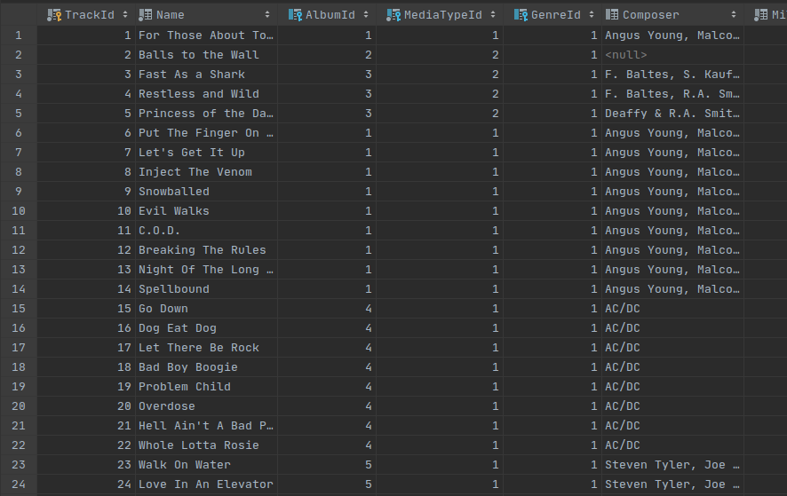
What is a Database?
A database is an organized collection of structured information, or data, typically stored electronically in a computer system
A database is usually controlled by a database management system (DBMS)
Notes:
Can be found online… but I can’t link to it

Slide 4
DBMS
Provides security
Handles schema modification
Provides isolation
Supports a multi-user environment that allows parallel data access and manipulation
Notes:
Can be found online… but I can’t link to it

Slide 5
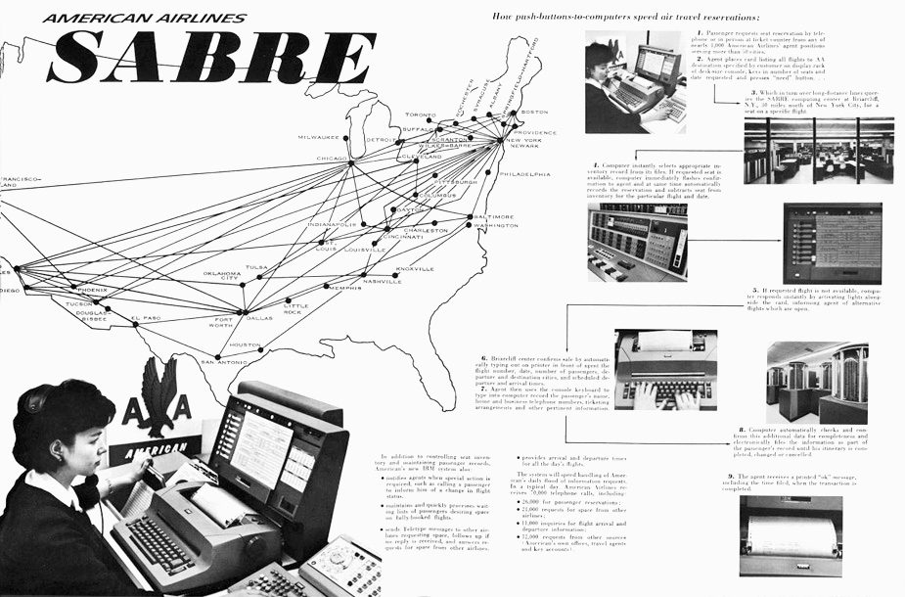
History
1960s - The first databases began to appear
Databases evolved from flat files
IBM SABRE system for airlines
Helped American Airlines handle reservations
Notes:
Can be found online… but I can’t link to it

Slide 6


History
1970s - E.F. Cobb proposes the relational database model
Ingres
QUEL query language
System R
SEQUEL query language
Notes:
Can be found online… but I can’t link to it

Slide 7
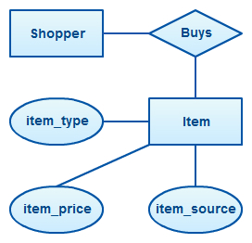
History
1970s - E/R Diagrams are proposed
Application designers could abstract away from table design
Notes:
Can be found online… but I can’t link to it

Slide 8
History
1970s - E/R Diagrams are proposed
Application designers could abstract away from table design…
Is this a good thing?
Notes:
Can be found online… but I can’t link to it

Slide 9

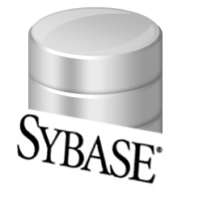
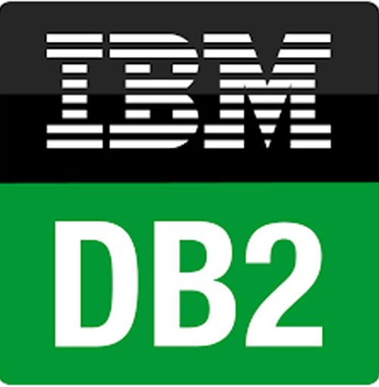

History
1980s to early 1990s: The Golden Age of Databases
SQL becomes a standard
Many new players
Lots of money was made
Notes:
Can be found online… but I can’t link to it

Slide 10
History
Early 1990s: Big Shakeout
Many vendors went bankrupt or became bit players
Even Oracle came close to bankruptcy in 1990
Accounting shenanigans
"an incredible business mistake"
Notes:
Can be found online… but I can’t link to it

Slide 11

History
Late 1990s: Internet Boom
A resurgence in vendors, Oracle and DB2 dominant
Microsoft started making inroads with a fork of Sybase called SQLServer
Today these are the three dominant commercial players
Notes:
Can be found online… but I can’t link to it

Slide 12



History
Late 1990s: Open Source Databases
1995 MySQL
Bought by oracle
1996 Postgresql
Based on Ingres at Berkeley
Go Bears
2000 SQLite
Super lightweight database
We are going to use it!
Notes:
Can be found online… but I can’t link to it

Slide 13


History
Post 2000 - Maturity
Three major commercial vendors
Two major open source options
Rise of NoSQL
We will look at two
MongoDB
Redis
Notes:
Can be found online… but I can’t link to it

Slide 14
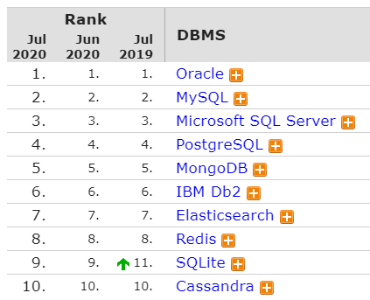
Today
Todays Database Rankings: https://db-engines.com/en/ranking
Rankings are pretty stable
Oracle continues to lead
SQLite is becoming more popular
Notes:
Can be found online… but I can’t link to it

Slide 15

What is a Database?
A system that stores and retrieves data
A query processor
Some sort of data definition language (DDL)
Typically provides network access
Not always! SQLite doesn’t!
Makes some guarantees about data
Notes:
Can be found online… but I can’t link to it

Slide 16
Sidebar: Why A Cylinder?
Probably due to the original appearance of hard disks
Notes:
Can be found online… but I can’t link to it

Slide 17

Sidebar: Why A Cylinder?
Probably due to the original appearance of hard disks
Notes:
Can be found online… but I can’t link to it

Slide 18
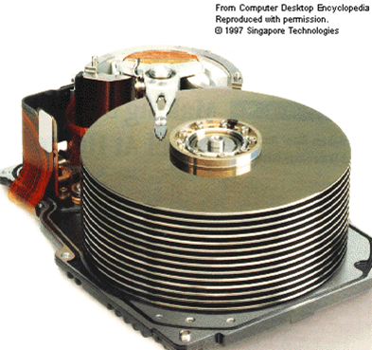
Sidebar: Why A Cylinder?
Probably due to the original appearance of hard disks
Notes:
Can be found online… but I can’t link to it

Slide 19

Sidebar: Why A Cylinder?
Probably due to the original appearance of hard disks
Oracle Headquarters...
Notes:
Can be found online… but I can’t link to it

Slide 20
Anyway, So, Back to Data
DBMS Guarantees = Transactions (mostly)
ACID
Atomicity - All completes or all fails
Consistency - Data consistency constraints are enforced
Isolation - Transactions complete as if no other transaction occurred
Durability - Data won’t be lost
Notes:
Can be found online… but I can’t link to it

Slide 21

ACID, Who needs it?
NoSQL stores often relax or more of these constraints for performance reasons
Very popular in the early 2010s!
Since then the industry has shown some regrets
A return to standard SQL systems or mixed systems
Notes:
Can be found online… but I can’t link to it

Slide 22

End of Course Goals
Be comfortable with the following:
Designing database schemas
Writing queries
Doing so from the web
Tuning queries for performance
Discussing general database architecture in a local and cloud context
Be employable
Notes:
Can be found online… but I can’t link to it

Slide 23
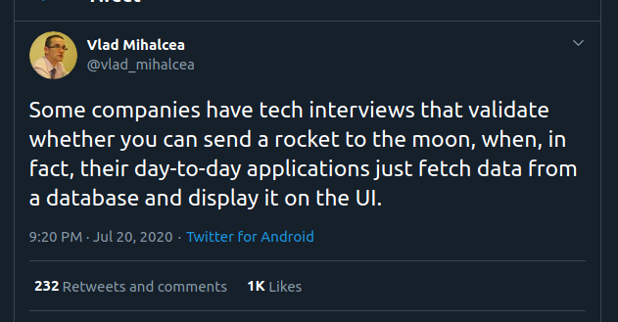
Database Systems
History & Context

